Slide 1
DIGITAL CAMERA BASICS
Photographic Imaging

Slide 2
What DSLR stands for
DSLR stands for “Digital Single Lens Reflex”.
A DSLR is a digital camera that uses mirrors to direct light from the lens to the viewfinder, which is a hole on the back of the camera that you look through to see what you are taking a picture of.

Slide 3
Diagram of a camera
Lens
Reflex mirror
Shutter
Image sensor
Matte focusing screen
Condenser lens
Pentaprism
Eyepiece/Viewfinder

Slide 4
Exposure
Exposure is the amount of light collected by the sensor in your camera during a single picture.
If the shot is exposed too long the photograph will be washed out and too bright.
If the shot is exposed too short the photograph will appear too dark.
The three primary controls your camera uses for exposure are aperture , shutter speed, and ISO.

Slide 5
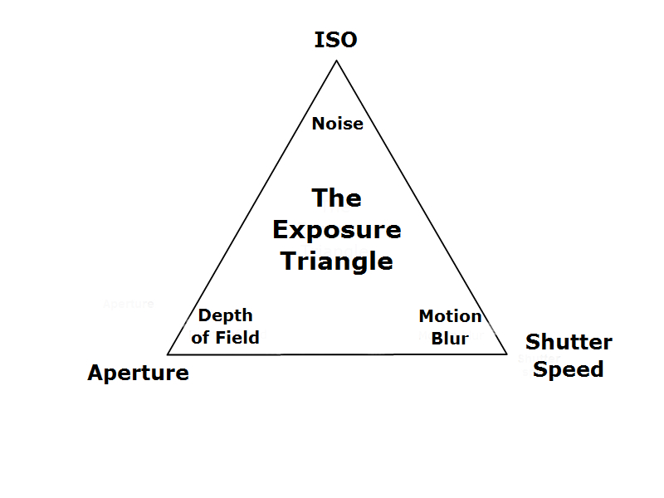

Slide 6
Aperture in a camera
Aperture is a hole within a lens, through which light travels into the camera body.
It is easier to understand the concept if you just think about our eyes. Every camera that we know of today is designed like human eyes.

Slide 7
Aperture basics
Depth of field (DOF) is the distance to which objects behind and in front of the focus point appear to be in focus.
Small apertures (high f/numbers ie f/22) increase the depth of field, bringing both the main subject, middle ground and background into focus. Creates a deep depth of field.
Large apertures (low f/numbers ie f/2.8) soften background details creating a shallow
depth of field.

Slide 8
Size of Aperture – Large versus Small Aperture
In photography, aperture is expressed in f-numbers (i.e. f/5.6). These f-numbers known as “f-stops” are a way of describing the size of the aperture, or how open or closed the aperture is.
A smaller f-stop means a larger aperture, while a larger f-stop means a smaller aperture. For example, f/1.4 is larger than f/2.0 and much larger than f/8.0.
The higher the f/number the smaller the hole.

Slide 9
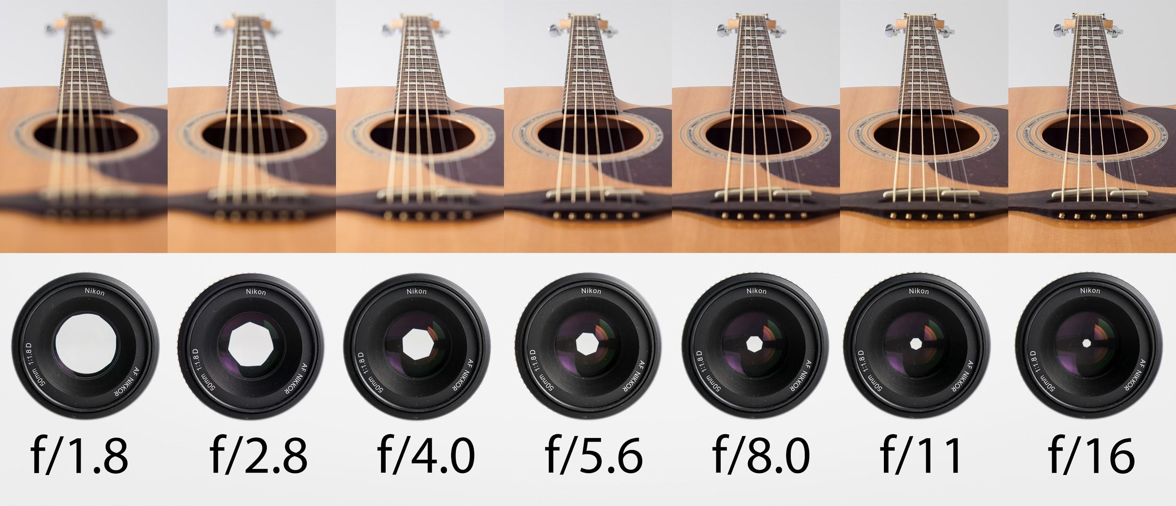

Slide 10
Image on left shot at f/2.8, image on right shot at f/8

Slide 11
Shutter Speed
Shutter speed, also known as “exposure time”, stands for the length of time a camera shutter is open to expose light into the camera sensor.
If the shutter speed is fast, it can help to freeze action completely.
If the shutter speed is slow, it can create an effect called “motion blur”, where moving objects appear blurred along the direction of the motion.

Slide 12
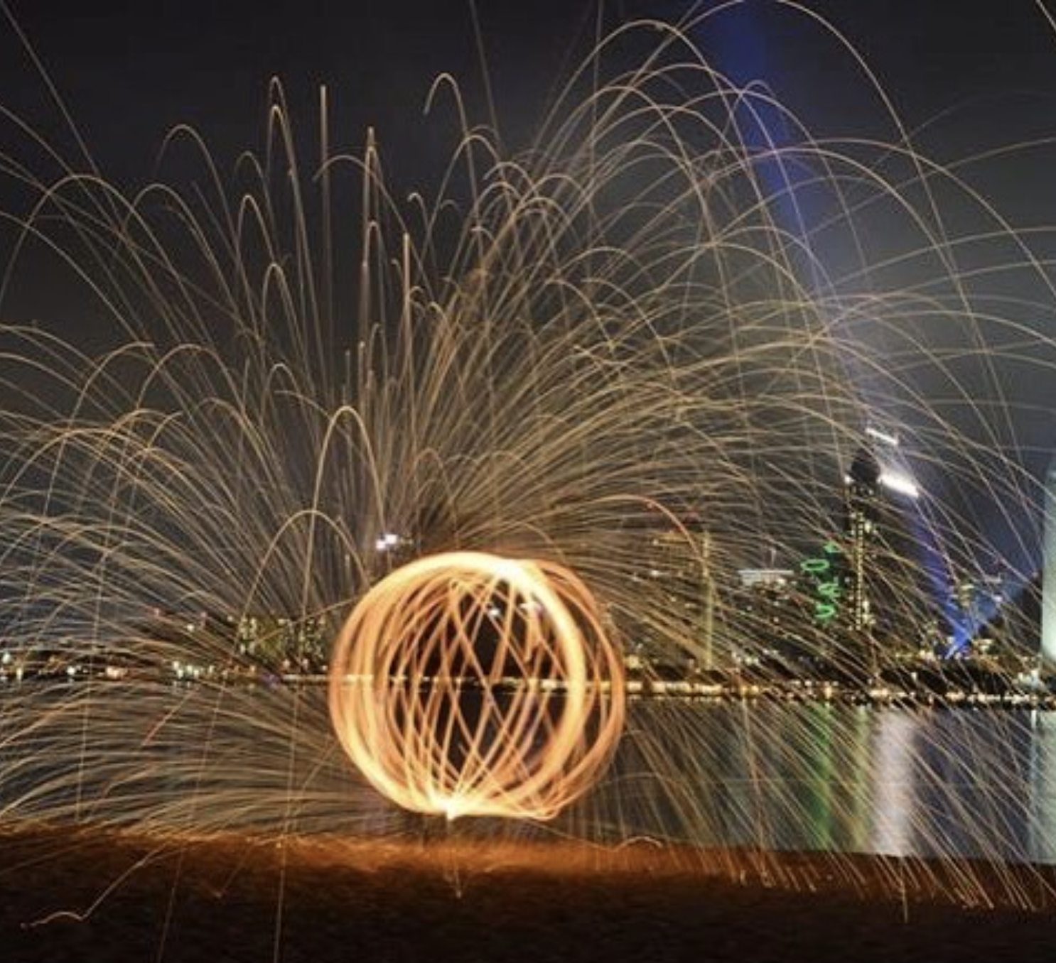
Slow shutter speed
w.instagram.com/p/BRhdUJHgK6y/?taken-by=kellymoncure

Slide 13
How shutter speeds are measured
Shutter speeds are typically measured in fractions of a second, when they are under a second.
For example 1/4 means a quarter of a second, while 1/250 means one two-hundred-and-fiftieth of a second or four milliseconds.

Slide 14
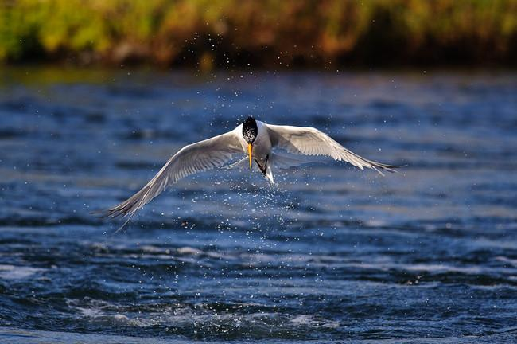
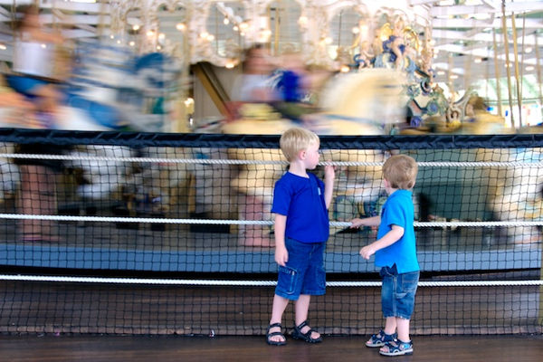
1/2000 second shutter speed
1/20 second shutter speed

Slide 15
Rule of thumb for shutter speed
The slowest shutter speed for handheld photography is 1/60. Anything lower then that should either be on a tripod or on a straight, solid surface.
Any slower handheld shutter speed begins to get motion blur and your photograph may be out of focus.

Slide 16
ISO
ISO is the level of sensitivity of your camera to available light.
The lower the ISO number, the less sensitive it is to the light, while a higher ISO number increases the sensitivity of your camera.
The component within your camera that can change sensitivity is called “image sensor” or simply “sensor”
With increased sensitivity, your camera sensor can capture images in low-light environments without having to use a flash. But higher sensitivity comes at an expense – it adds grain or “noise” to the pictures.

Slide 17
Low ISO versus High ISO

Slide 18
What ISO to use
When there is plenty of light, you should always use the lowest ISO, to retain the most detail and to have the highest image quality.
There are some cases where you might want to use low ISO in dim or dark environments – for example, if you have your camera mounted on a tripod or sitting on a flat surface.

Slide 19
General rule of thumb
Bright and sunny, 100 iso
Cloudy, 250 iso
Indoors, 400 iso
Night time without a flash, 1600 iso

Slide 20
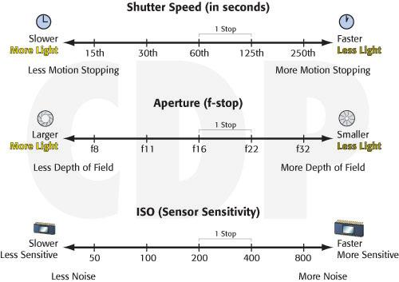

Slide 21
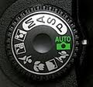
Modes on the DSLR
M- Manual Control over aperture and shutter
A- Aperture Priority
S- Shutter Priority
P- Camera sets shutter speed and aperture

Slide 22
Control Panel
Shows the ISO, shutter speed, aperture, white balance, amount of images left on the memory card, and image size.

Slide 23
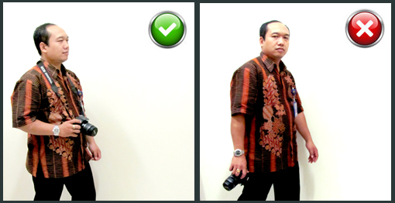
How to hold a DSLR
Have the camera strap around your neck at all times and
Hold the camera by the lens and hand grip if possible- treat with care!

Slide 24
What to check for after taking a photograph
Is the image over exposed/ under exposed?
Is the image in focus?
Is the image cut off or hard to see?
Is the image visually interesting?
Are there any distracting elements in the background that shouldn’t be there?
Should you change your point of view and get closer/further/lower/higher and reshoot?

